Slide 1
Challenges for (space) robotics applications
Assumes tasks are sampled iid from a distribution over tasks
More likely, we have some idea what the next task is based on current task
Assumes meta-dataset is segmented by task: known task boundaries
More likely, world changes without our complete knowledge
Difficult to characterize uncertainty in learning
How to handle “out of distribution tasks”

Slide 2
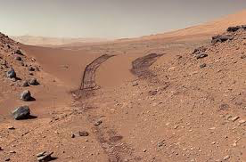
Continuous meta-Learning without tasks
Tasks occur sequentially, often without indication of change.
Component failure
Environmental dynamics change (e.g., terrain changes)
Goals of humans interacting with robot change
Goals:
Learn to few-shot learn, without access to expert knowledge of task changes
Rapidly identify and adapt to task change at test time
Notes:
rover transitioning from hard terrain to soft terrain, for example
sand dunes

Slide 3
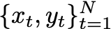
Problem setting
We observe time series data (e.g. state, action, next state tuples), in which the task changes with some probability at each time step
No knowledge of when the task change occurs (although this can easily be relaxed)
Want to maximize predictive performance on a test time series, also with changing tasks

Slide 4
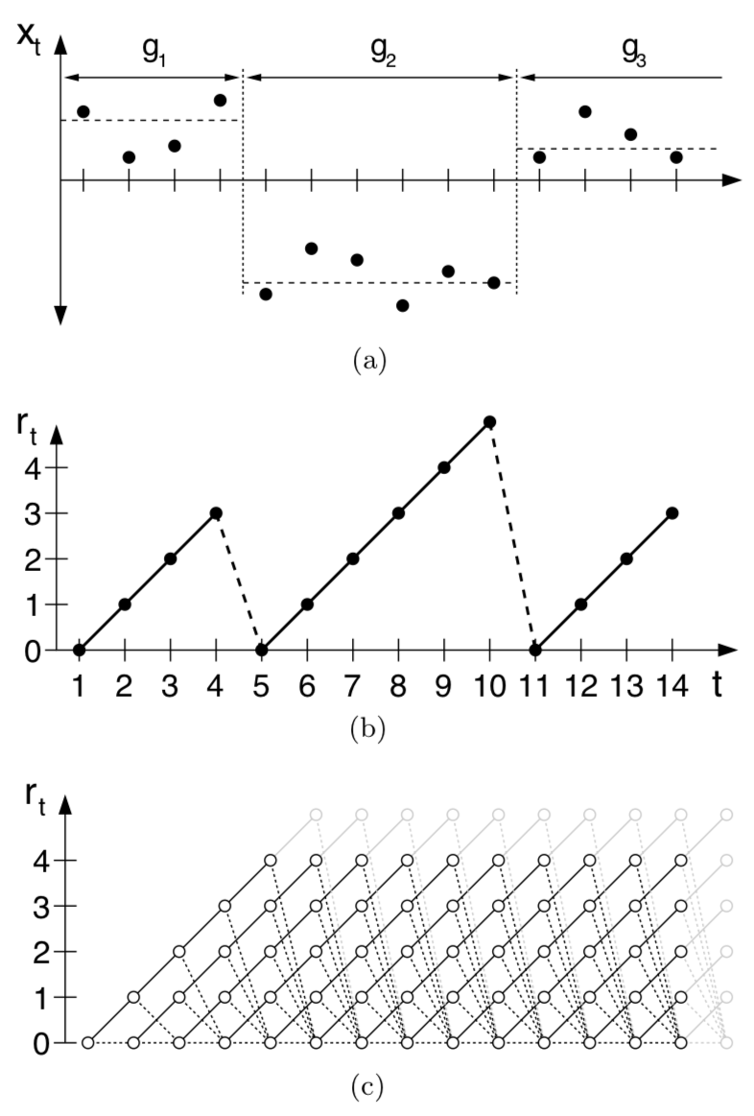
Background: Bayesian online changepoint detection
Our approach extends BOCPD [Adams and Mackay, 2007]
Require:
Underlying predictive model (ideally, capable of recursive updates)
Maintain:
Belief over task duration/run length (for all run lengths)
Statistics of posterior distribution for each run length
At each time:
Observe data sampled from current task
Recursively update belief over task duration based on how well posterior predicts new data
Update posterior statistics for each run length

Slide 5
Meta-learning via Online Changepoint Analysis (MOCA)
Main idea: BOCPD performs a soft belief update (no explicit maximization), so can backpropagate through it.
We use a meta-learning algorithm as the underlying predictive model in BOCPD, and backprop through BOCPD to train.
MOCA jointly learns an efficient meta-learning model and to identify task change in time series data.

Slide 6
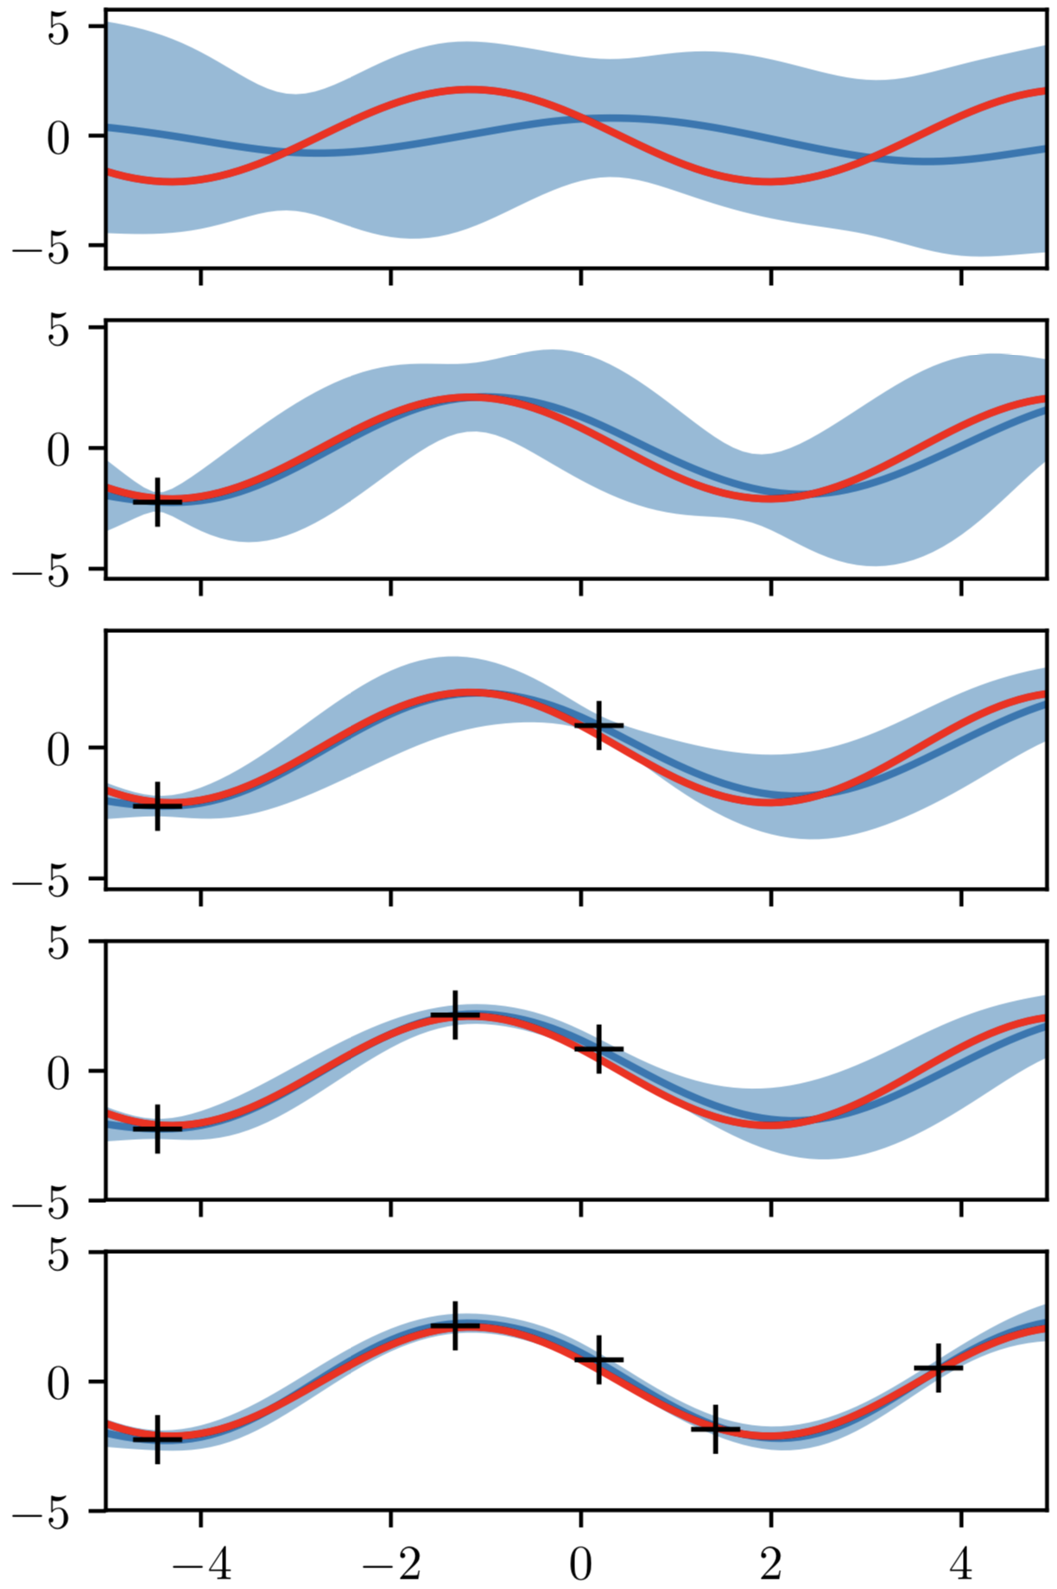
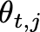
MOCA for regression
For the underlying meta-learning model, we use ALPaCA [Harrison et al., 2018]
ALPaCA performs Bayesian linear regression on the last layer of a neural network: parametric Gaussian process regression
Network weights ( ) and last layer prior ( ) are learned by backpropagating through the last layer posterior ( )
Notes:
Exact posterior inference
Efficient recursive updates
Relatively low dimensional statistics
Efficient network evaluation re-use

Slide 7
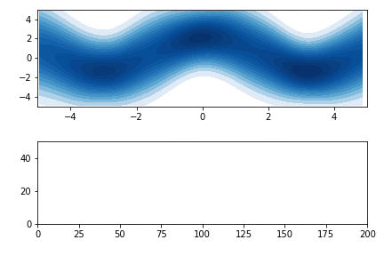
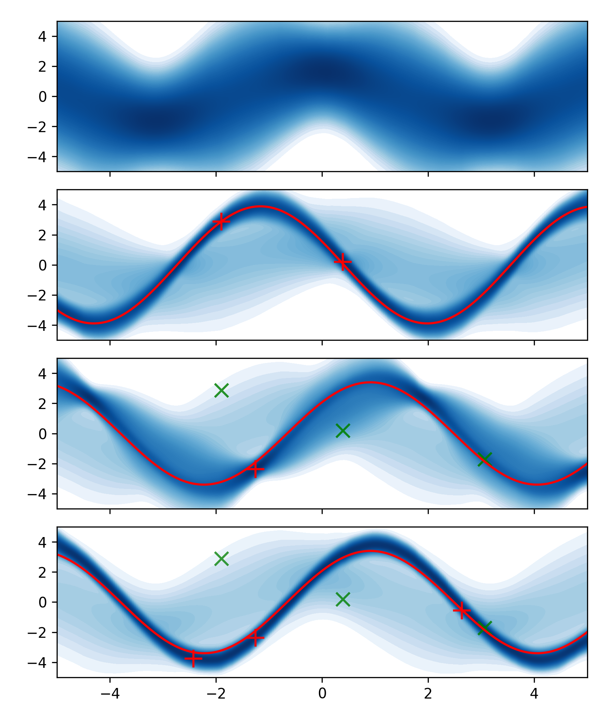
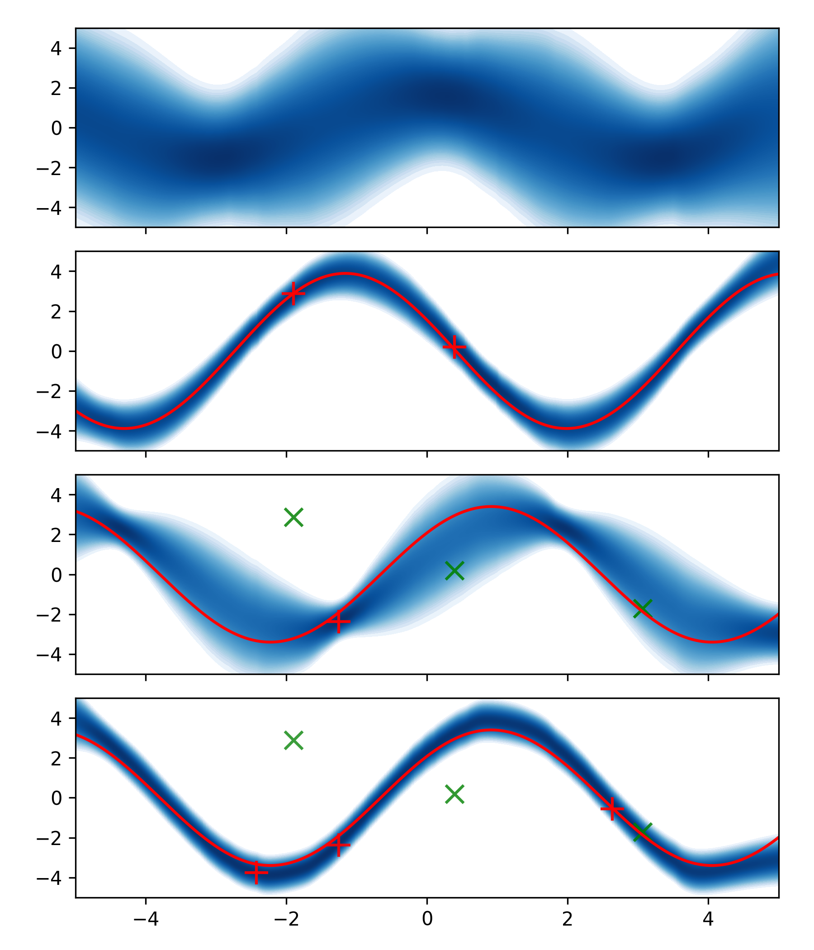
Regression results
MOCA
Oracle
Belief over run length
Time
Red bars: true changepoints

Slide 8
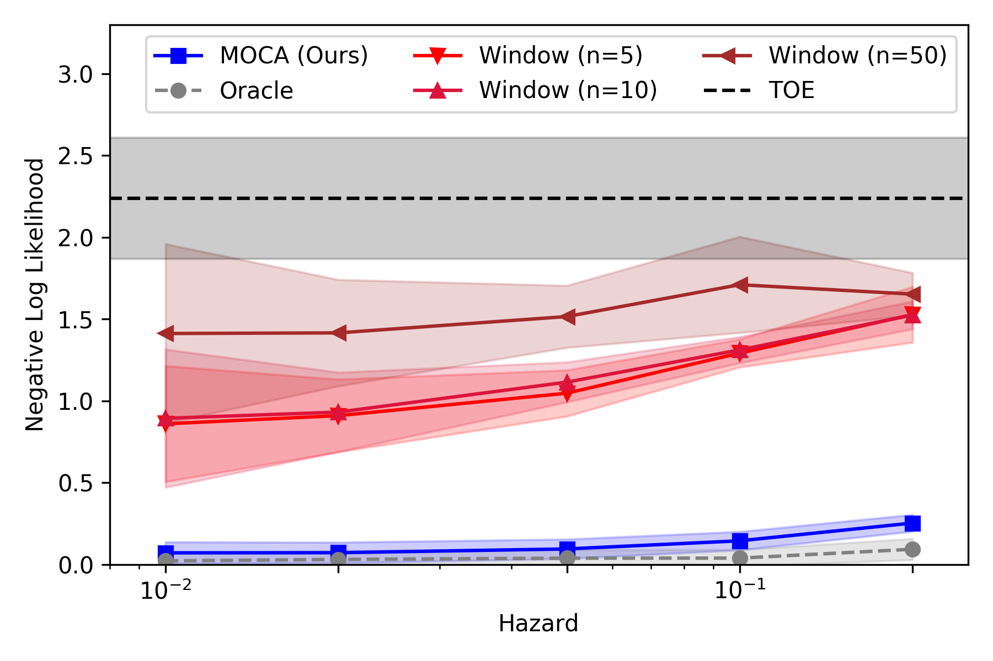
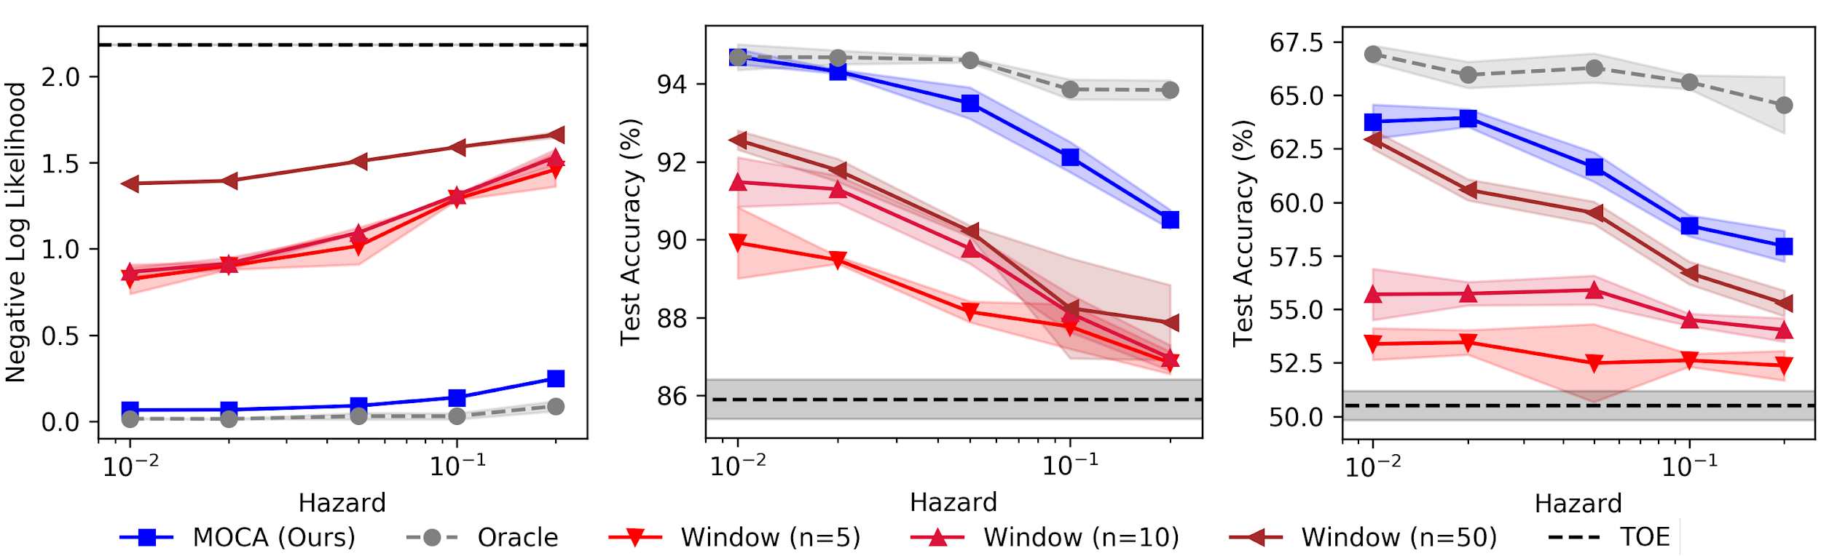
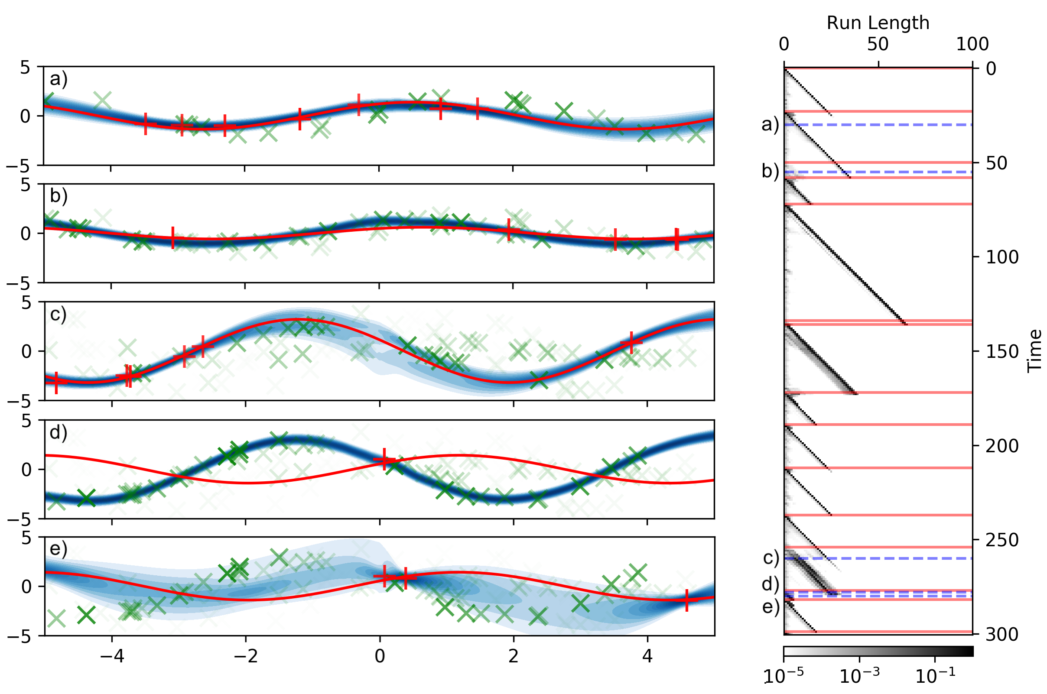
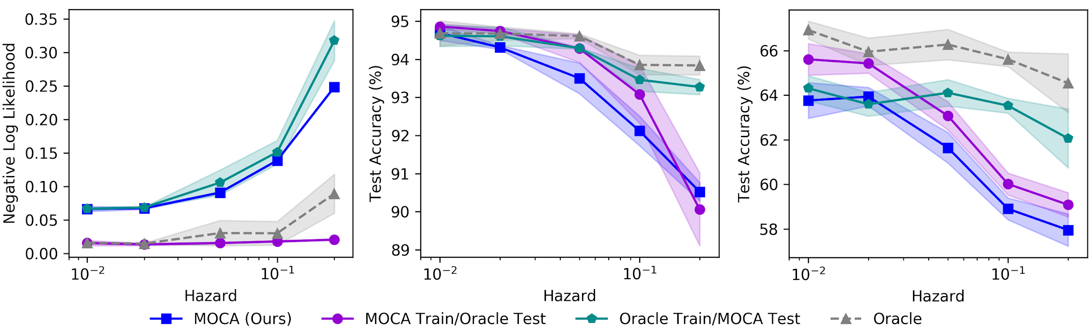
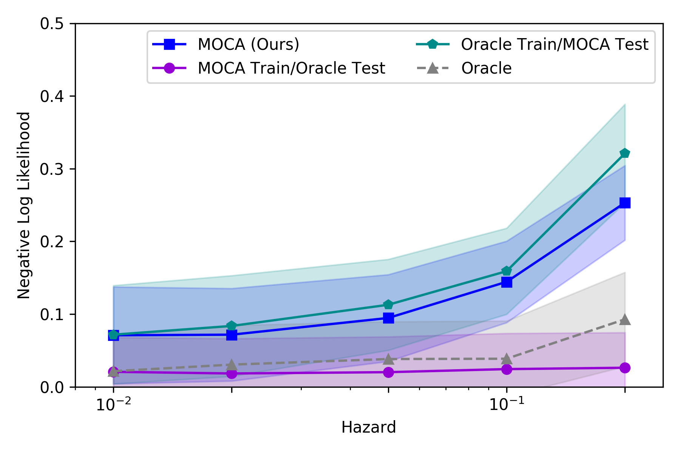
Regression results

Slide 9
Applications to robot autonomy and current work
The time series problem formulation of MOCA is natural for robotic systems
Ongoing work:
Continual robotic learning
Failure detection for autonomous robots
Model Extensions:
Non-i.i.d. tasks
Tasks of non-random duration
For more details: Harrison, Sharma, Finn, and Pavone. Continuous Meta-Learning without Tasks. Submitted to ICLR 2020 (available on OpenReview).

Slide 10
Safe learning for control framework
Based on iterative exploit-explore scheme.
Necessary components:
Calibrated uncertainty propagation
Uncertainty-aware control and trajectory optimization
Statistical bounds on learning rate

Slide 11
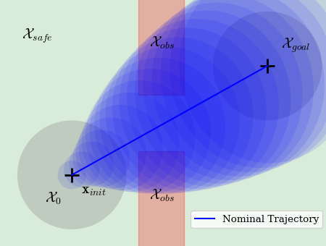

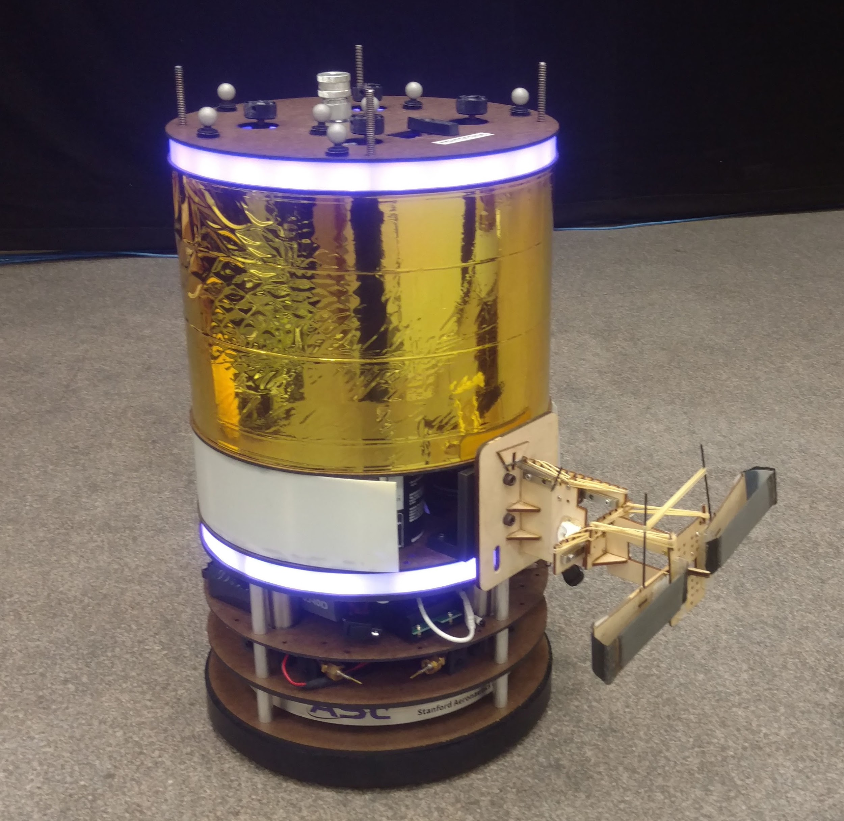
Safe learning for control framework
Based on iterative exploit-explore scheme.
Necessary components:
Calibrated uncertainty propagation
Uncertainty-aware control and trajectory optimization
Statistical bounds on learning rate
Try to reach safe goal region using uncertainty propagation and trajectory optimization.
Free-flyer space robot, with unknown thruster dynamics and mass.

Slide 12
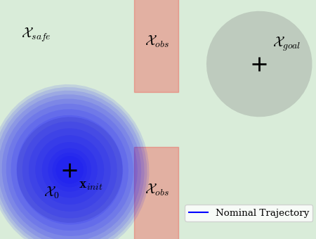

Safe learning for control framework
Based on iterative exploit-explore scheme.
Necessary components:
Calibrated uncertainty propagation
Uncertainty-aware control and trajectory optimization
Statistical bounds on learning rate
Because exploitation is not safe, turn instead to exploration around a safe initial set.
Free-flyer space robot, with unknown thruster dynamics and mass.

Slide 13
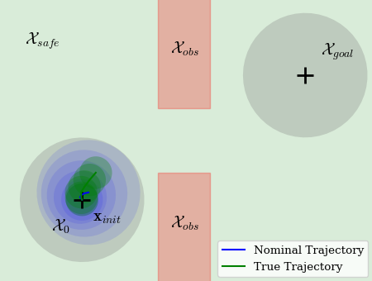

Safe learning for control framework
Based on iterative exploit-explore scheme.
Necessary components:
Calibrated uncertainty propagation
Uncertainty-aware control and trajectory optimization
Statistical bounds on learning rate
1
Still unsafe, so reduce horizon of exploration until a safe exploration trajectory is available.
Free-flyer space robot, with unknown thruster dynamics and mass.

Slide 14
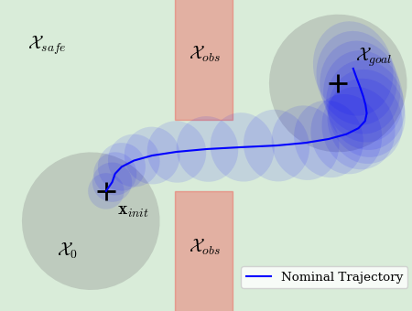
Safe learning for control framework
Based on iterative exploit-explore scheme.
Necessary components:
Calibrated uncertainty propagation
Uncertainty-aware control and trajectory optimization
Statistical bounds on learning rate
After exploration, try again to exploit.
1
Free-flyer space robot, with unknown thruster dynamics and mass.

Slide 15
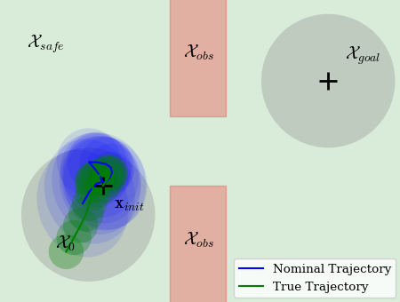
Safe learning for control framework
Based on iterative exploit-explore scheme.
Necessary components:
Calibrated uncertainty propagation
Uncertainty-aware control and trajectory optimization
Statistical bounds on learning rate
2
Exploitation unsafe, so explore again. As model knowledge is improved, exploration actions are more ambitious.
1
Free-flyer space robot, with unknown thruster dynamics and mass.

Slide 16
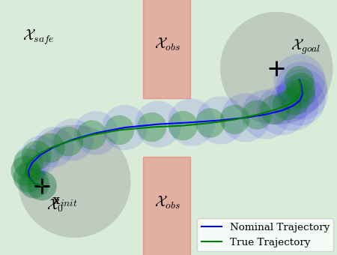
Safe learning for control framework
Based on iterative exploit-explore scheme.
Necessary components:
Calibrated uncertainty propagation
Uncertainty-aware control and trajectory optimization
Statistical bounds on learning rate
5
...
2
After several iterations of safe exploration, can safely solve the problem.
1
Free-flyer space robot, with unknown thruster dynamics and mass.

Slide 17
Safe learning for control framework
Based on iterative exploit-explore scheme.
Necessary components:
Calibrated uncertainty propagation
Uncertainty-aware control and trajectory optimization
Statistical bounds on learning rate
Currently in progress:
Most outer bound methods rely on global Lipschitz constants: way too conservative!
Instead decompose sets and use local Lipschitz constants

Slide 18
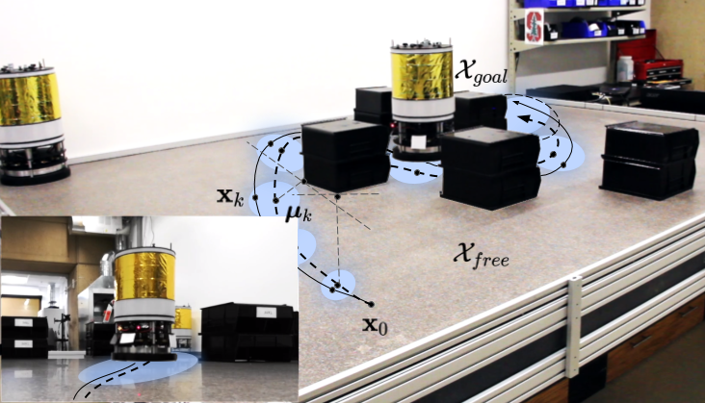
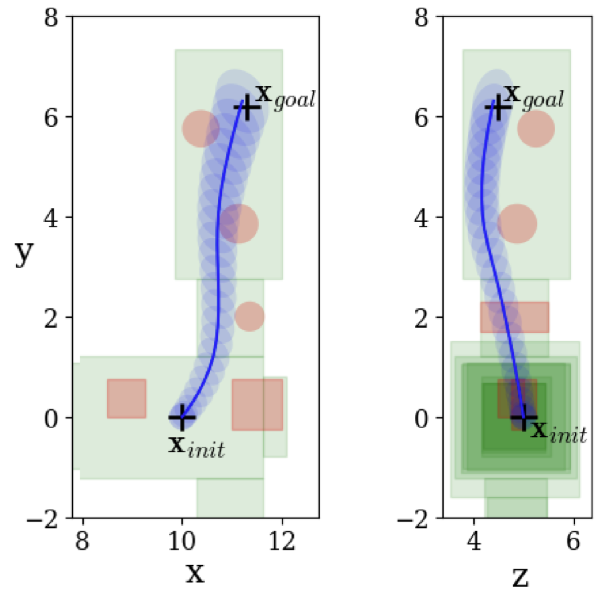
Safe learning for control framework
Based on iterative exploit-explore scheme.
Necessary components:
Calibrated uncertainty propagation
Uncertainty-aware control and trajectory optimization
Statistical bounds on learning rate
CC-GUSTO for chance constrained trajectory optimization.
In progress: particle consensus-based model predictive control.
CC-GUSTO: Lew, Bonalli, and Pavone. Theoretically Guaranteed Chance-Constrained Sequential Convex Programming for Robust Trajectory Optimization. Submitted to ECC 2020.

Slide 19
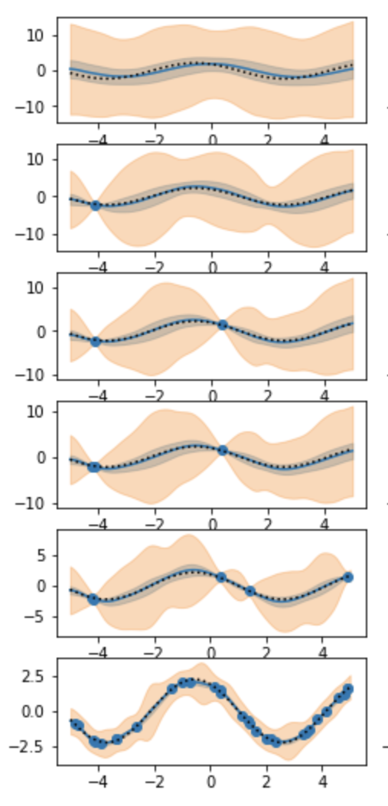
Safe learning for control framework
Based on iterative exploit-explore scheme.
Necessary components:
Calibrated uncertainty propagation
Uncertainty-aware control and trajectory optimization
Statistical bounds on learning rate
Because ALPaCA performs Bayesian linear regression, we can leverage martingale results from linear bandits that hold for sub-Gaussian noise.
Blue: 95% confidence interval.
Orange: Inflated confidence interval accounting for action selection.

